Slide 1

CIKM-2023 Tutorial: Some Useful Things to Know When Combining IR and NLP: the Easy, the Hard and the Ugly
Omar
Ken
Omar Alonso, Amazon, Santa Clara, CA, USA
Kenneth Church, Northeastern University, San Jose, CA, USA

Slide 2
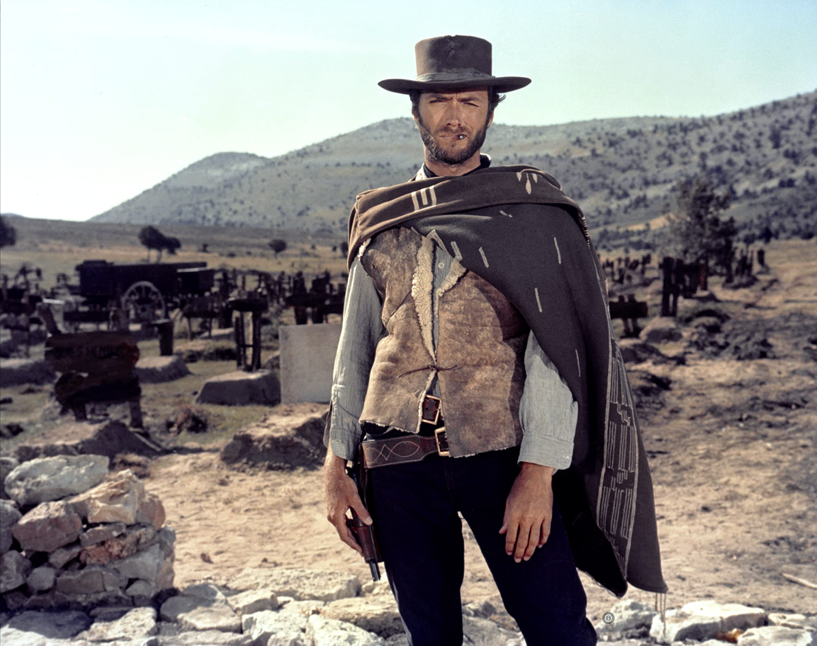

The Easy, the Hard and the Ugly
Easy
Inference (fit)
Fine-Tuning (predict)
Hard
Pre-training
Ugly (Responsible AI)
Bias
Toxicity
Misinformation
Hallucinations
Plagiarism

Slide 3
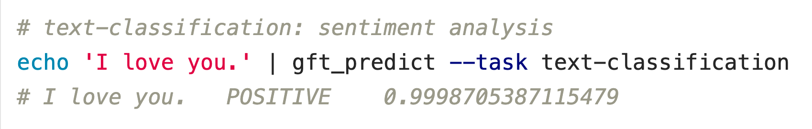



Easy: Classification
$$f\left(x\right)→\hat{y}$$
$$x$$
$$\hat{y}$$
Score
Little Language
aka, Domain Specific Language (DSL)

Slide 4
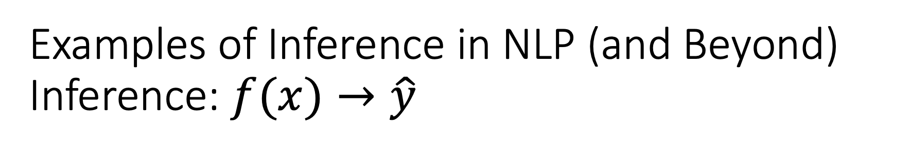
Examples of Inference in NLP (and Beyond) Inference: $f(x)→\hat{y}$
Classification
Sentiment
Emotion
Hate Speech
Cloze Task (Fill Mask)
Part of Speech Tagging
Question Answering (SQuAD)
Entailment (GLUE)
Machine Translation
Speech
Speech-to-Text
Text-to-Speech
Vision
Classify Objects
Add Captions

Slide 5
More Inference Tasks: Classification, Fill Mask, … echo … | gft_predict –task fill-mask
Input | Choice 1 |  | Choice 2 |  | Choice 3 |  | Choice 3 |  | All Other Choices
I <mask> you | miss | 30% | love | 17% | salute | 16% | thank | 7% | 37%
I <mask> him | love | 14% | miss | 13% | forgive | 6% | salute | 5% | 68%
I <mask> her | love | 16% | miss | 12% | forgive | 5% | adore | 5% | 67%
I love <mask> | him | 2% | cats | 2% | her | 2% | it | 1% | 94%
I <mask> New York | love | 33% | miss | 17% | hate | 15% | LOVE | 3% | 36%
I love the <mask> guy | pizza | 2% | funny | 2% | old | 1% | bald | 1% | 95%
I hate the <mask> guy | fucking | 3% | pizza | 2% | bad | 2% | wrong | 2% | 93%

Slide 6
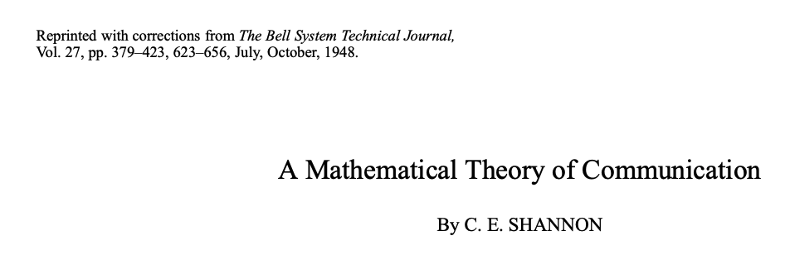
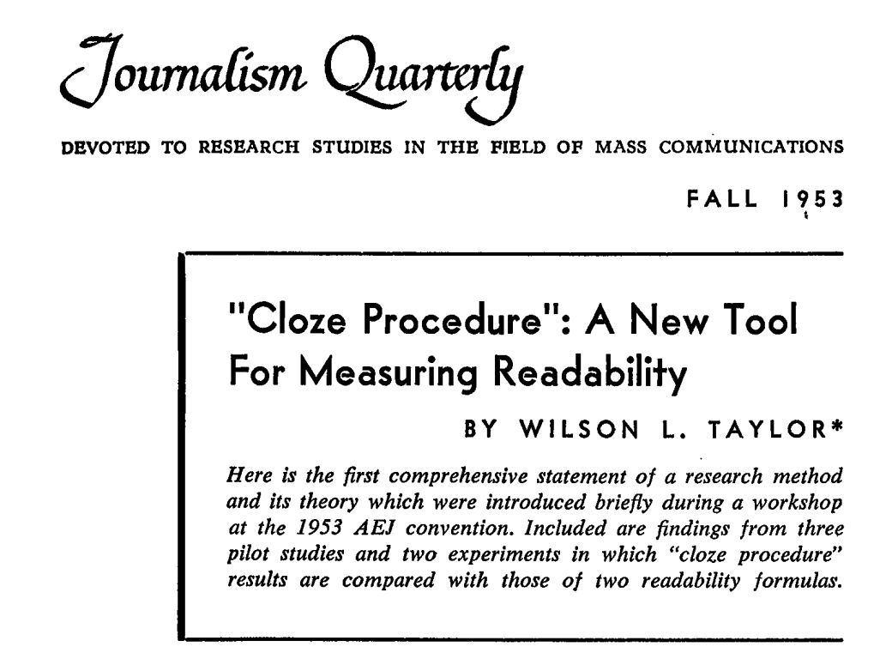
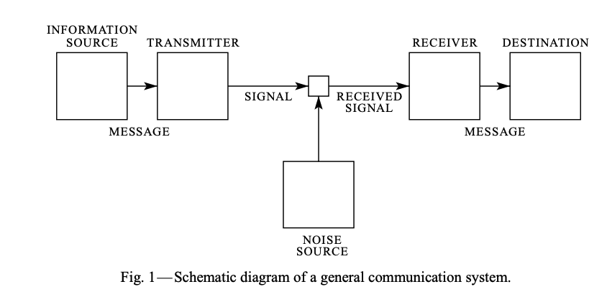
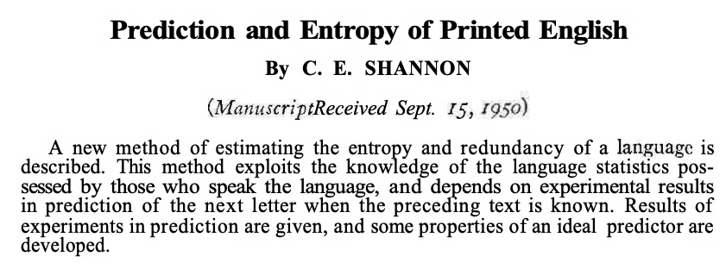
Lots of History
Shannon Entropy (1948)
Information Theory, Electrical Eng
Cloze Task (1953)
from Gestalt Psychology

Slide 7
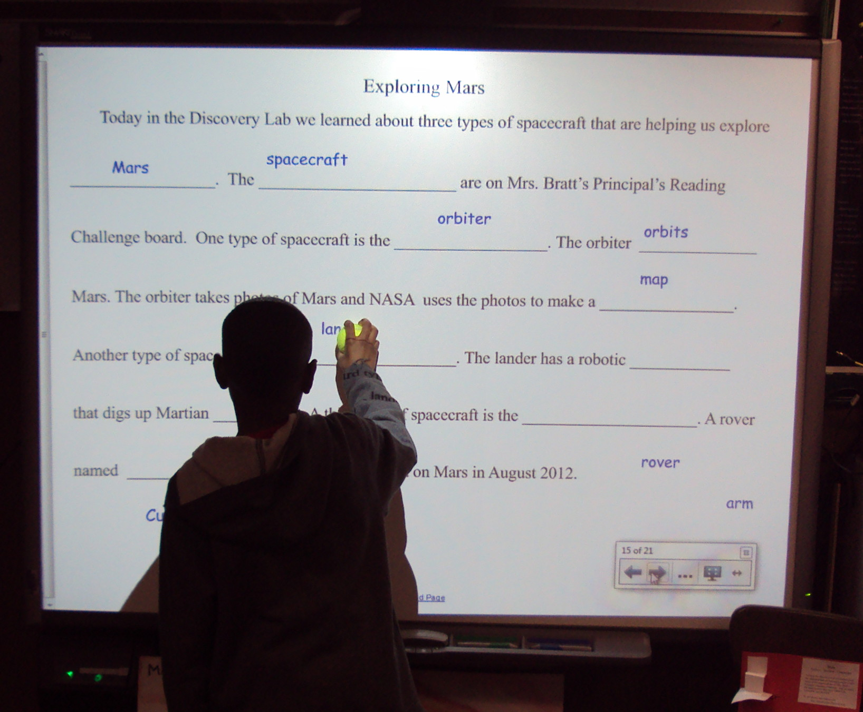
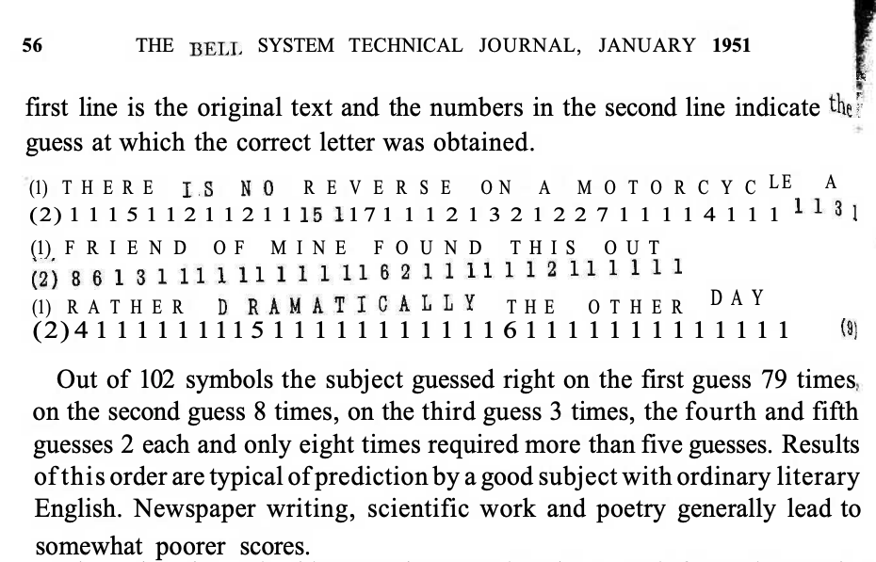
Cloze Task (aka, Fill Mask, “Hangman,” “The Match Game”)
Shannon Entropy (1940s & 1950s)
Information Theory, Electrical Eng
Cloze Task (1953)
Gestalt Psychology
By Laurie Sullivan - DSC01784, CC BY 2.0, https://commons.wikimedia.org/w/index.php?curid=62727253

Slide 8
More Inference Tasks: Classification, Fill Mask, … echo … | gft_predict –task fill-mask
BERT: Fill-Mask (Delvin et al, 2019)
Cloze Task (1953)
Input | Choice 1 |  | Choice 2
I <mask> you | miss | 30% | love | 17%
I <mask> him | love | 14% | miss | 13%
I <mask> her | love | 16% | miss | 12%
I love <mask> | him | 2% | cats | 2%
I <mask> New York | love | 33% | miss | 17%
I love the <mask> guy | pizza | 2% | funny | 2%
I hate the <mask> guy | fucking | 3% | pizza | 2%
By Laurie Sullivan - DSC01784, CC BY 2.0, https://commons.wikimedia.org/w/index.php?curid=62727253

Slide 9


Recurring Theme: Lots of History
When I took my first course in AI
I was led to believe it was all “new”
But when I expressed too much enthusiasm
profs with more experience would roll their eyes
Many of ideas (good, bad & ugly)
have lots of history

Slide 10
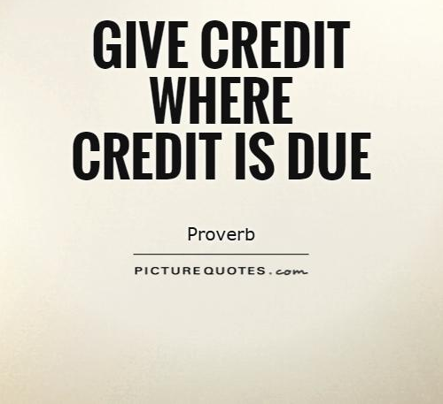
Terminology
Standard debating trick (Chomsky)
Introduce non-standard terminology
(to give insiders an unfair advantage)
Let’s be inclusive (and use standard terminology, when possible)
Interference → Predict
Fine-tuning → Fit
Fill-mask → Entropy / Cloze task

Slide 11
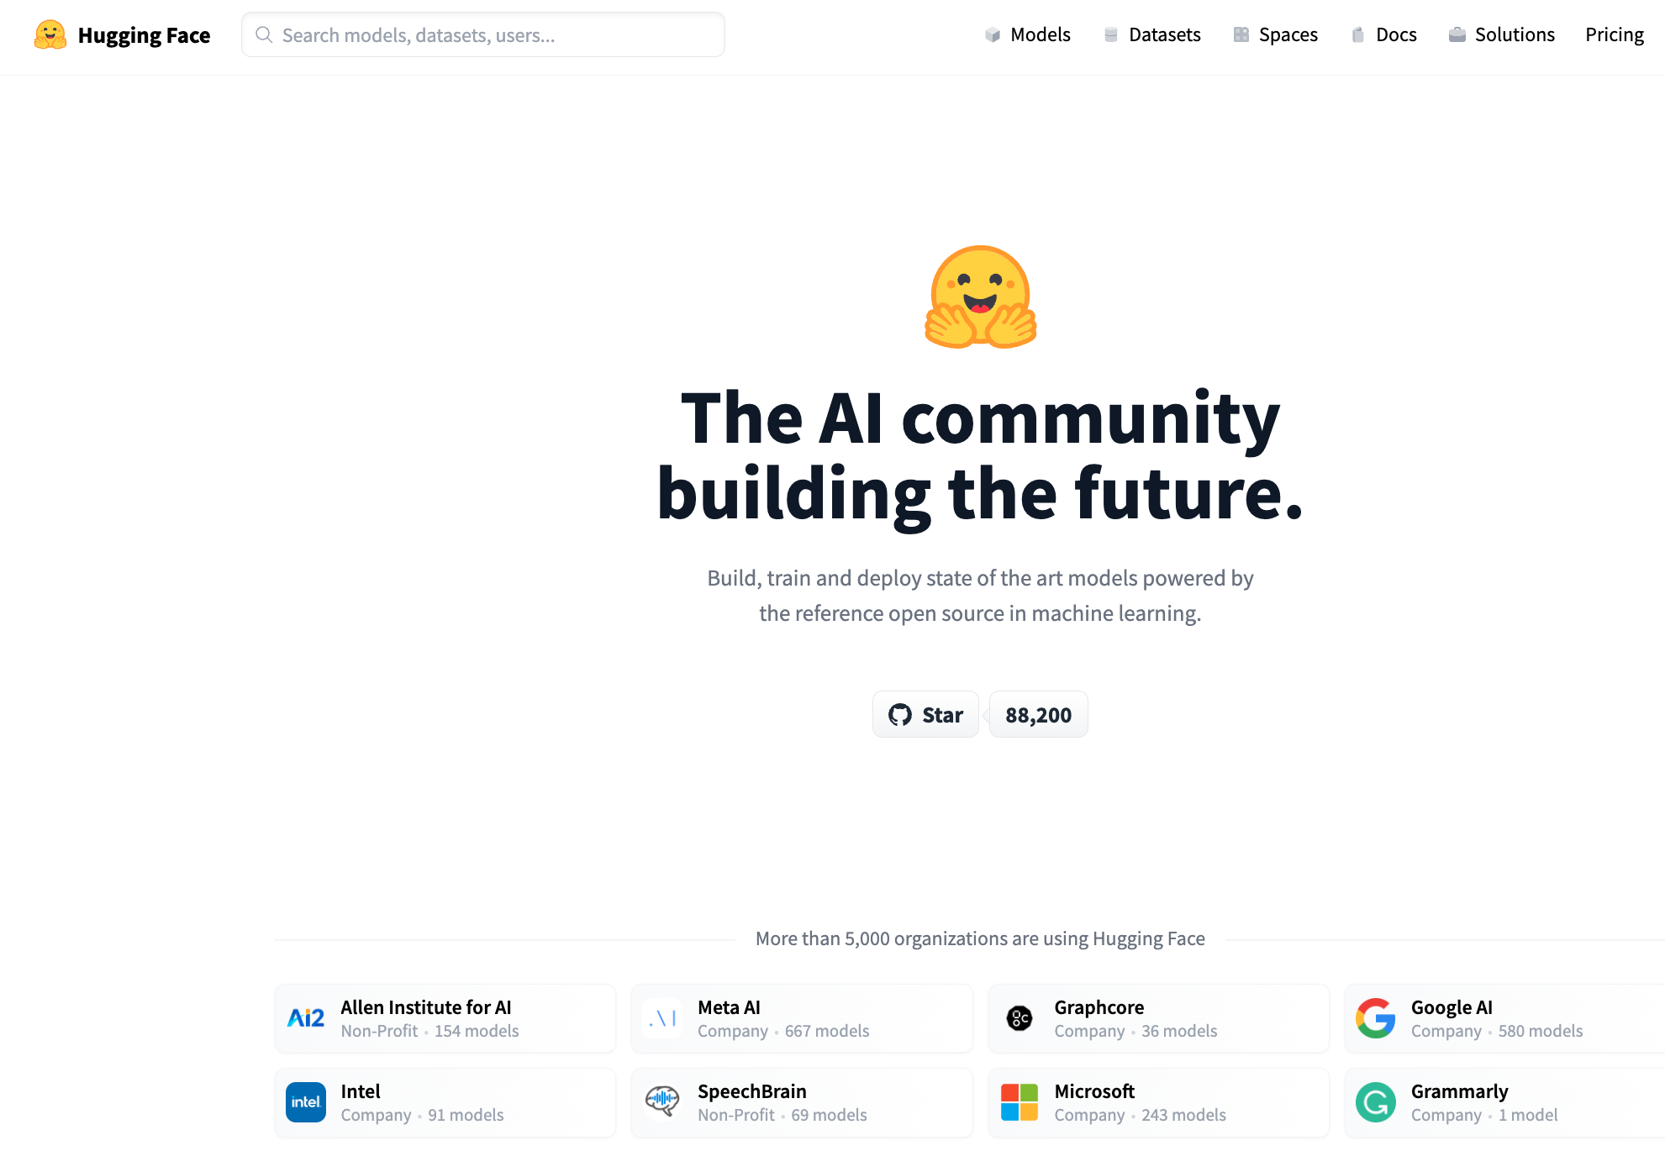




Resources
DataSets (Benchmarks)
Hubs
Examples
GLUE (NYU)
SQuAD (Stanford)
Features
Splits:
Test, Validation (Dev), Train
Metrics
Leaderboard
Examples
HuggingFace https://huggingface.co/
PaddleHub (Baidu, China)
Features
Datasets (50k)
Models (300k)
Apps (100k)
Community Engagement
(Social Media)
Growing Quickly
($=10$x/year)

Slide 12
Useful Skills
Extremely Easy/Valuable (inference/predict)
Ability to download datasets and models from hubs
and use them (as is, for their intended purpose)
Many grad students (and undergrads) can do this
but less so, for people with “more” experience
Very Easy/Valuable (fine-tuning/fit)
Ability to modify models on hubs
and use them in novel ways

Slide 13
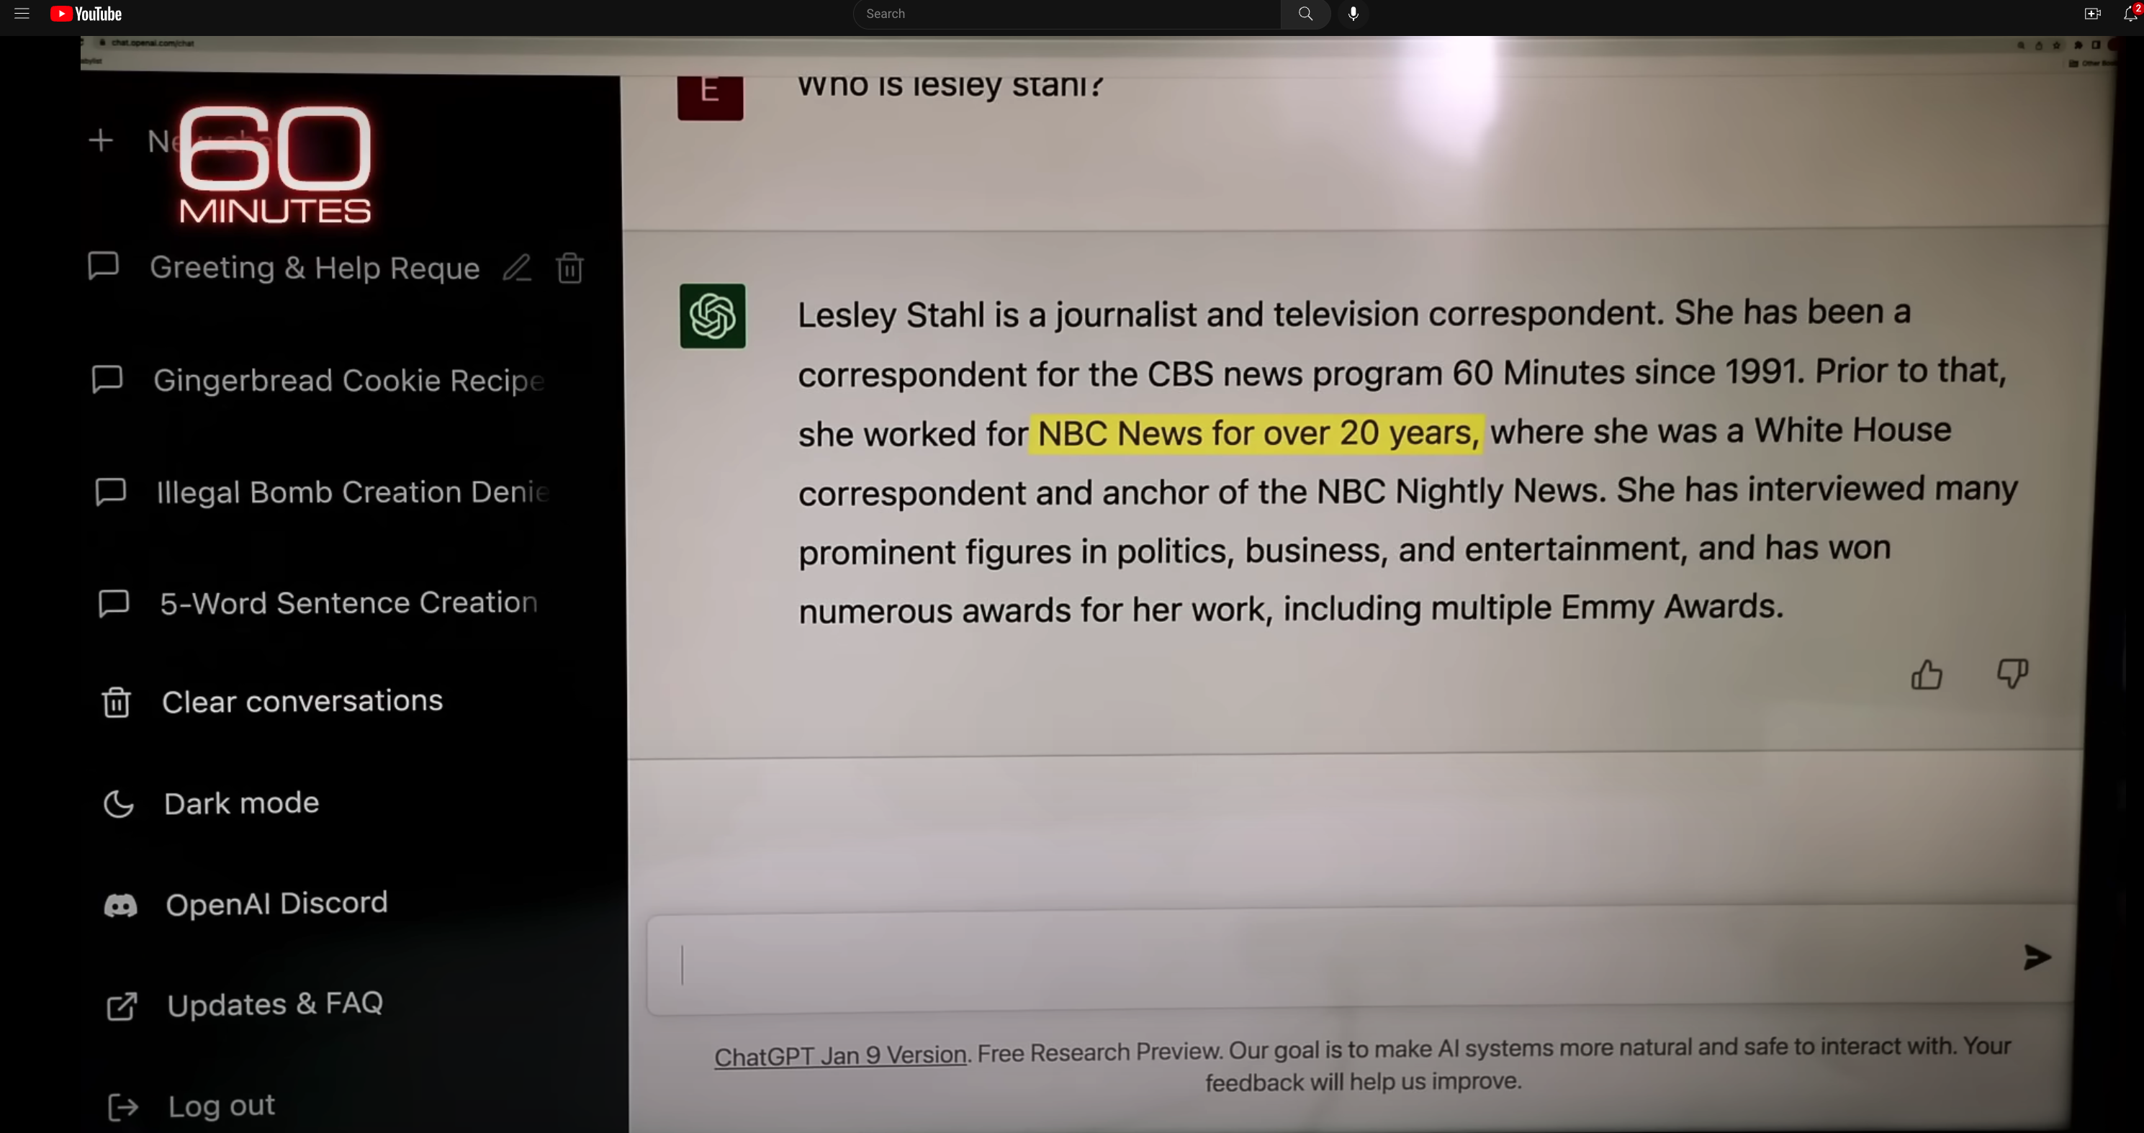
What’s new; Why so much recent excitement?
Prompting is programming
Prompt Engineering: Who is Lesley Stahl
“Hallucination” has become a technical term

